Slide 1


Slide 2

Tutorial 7 Sections 009/010
TA: Greydon Gilmore
Physiology 2130
Oct 22nd, 2019

Slide 3

Your TA reminding you…
1st Quiz (1%)
Opens: Oct 21st @ 4pm
Closes: Oct 22nd @ 4pm
1st Midterm - Oct 25th @ 6pm-7pm (15%)
Midterm Review session
When: Wednesday, Oct 23rd from 6:00-8:00pm
Where: Auditorium C, University Hospital, 3rd floor

Slide 4
Today
No group work!
Learning Catalytics Question
Basal ganglia
Anterior pituitary and thyroid
Thyroid Gland and Adrenal Gland

Slide 5
Question from email/anonymous suggestion box…

Slide 6
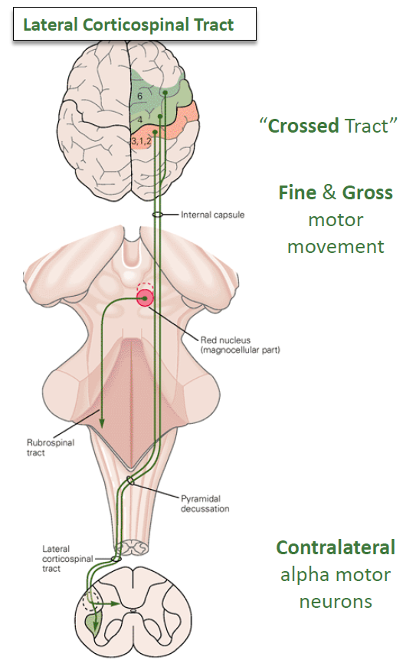
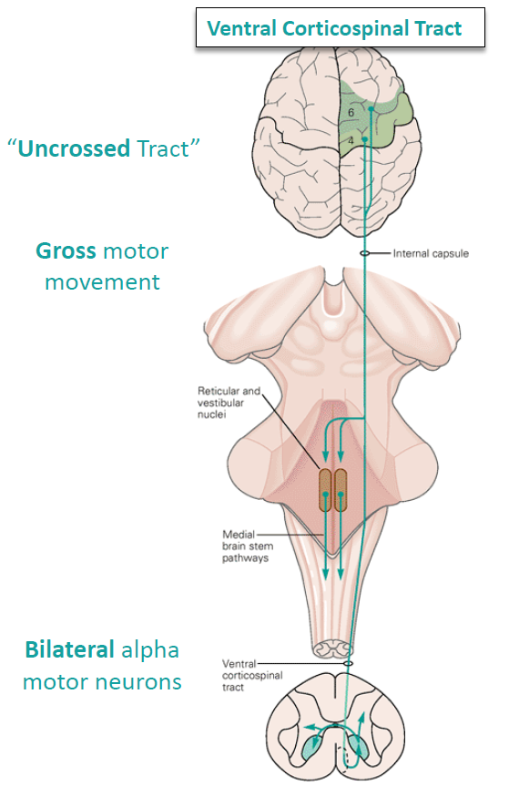
Lateral vs. Ventral Corticospinal Tracts
Dorsal Lateral Corticospinal tract
Contralateral
Crosses at the pyramids of the medulla
80-90% of this pathway
Fine gross motor movements
Ventral Medial Corticospinal tract
Ipsilateral
Crosses at the spinal cord
Gross motor movements
Affects motor neurons on both sides of the body

Slide 7
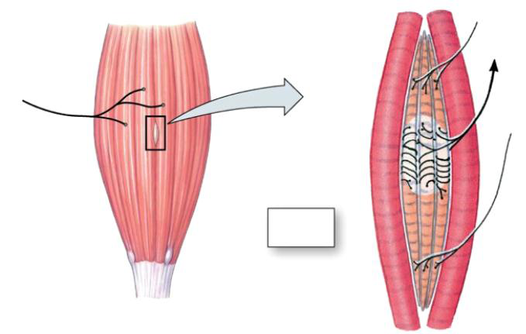
I really don't get the concept of gamma motor neurons and 1a and 1b afferent neurons so if you can just revise these it would be really helpful.
Gamma Motor Units
Extrafusal Muscle Fibres
1a afferent neuron (stretch)
Alpha Motor Unit
Intrafusal muscle

Slide 8
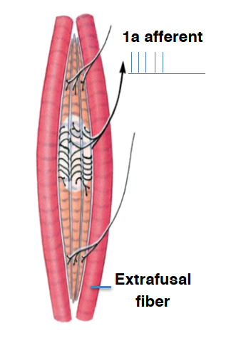
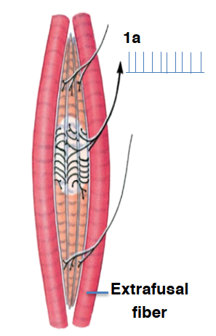
I really don't get the concept of gamma motor neurons and 1a and 1b afferent neurons so if you can just revise these it would be really helpful.
Alpha motor neuron without gamma motor neuron would lead to loss of 1a firing
If gamma not contracting intrafusal, stretch of muscle will not be able to be detected (dangerous)
Alpha motor neuron with gamma motor neuron would maintain 1a firing
With gamma contracting intrafusal, stretch of the muscle can still be detected

Slide 9
Would you be able to go over the cerebellum and basal ganglia in more detail, particularly the cerebellar circuit. I’m not sure I fully understand the concepts
Will be covered in todays lecture slides

Slide 10
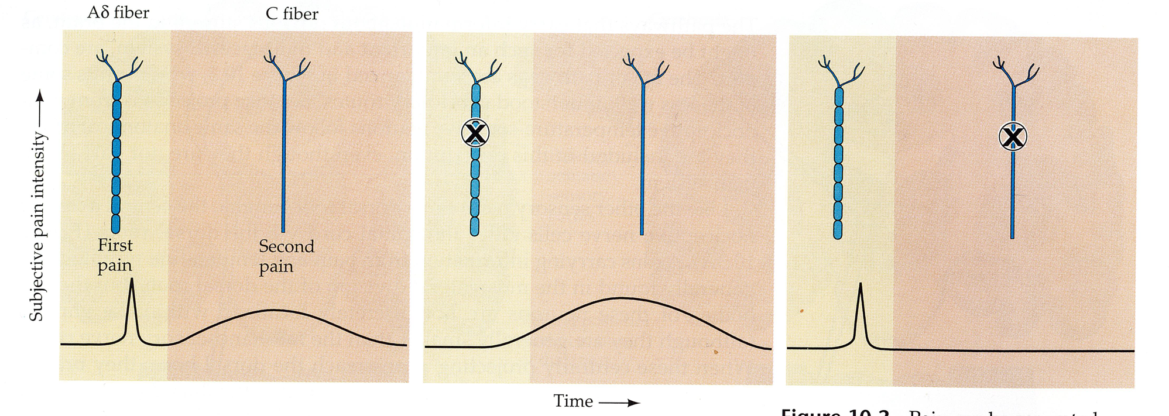
Where were type C fibers mentioned?
Dr. Everling, Lecture 2, Slide 23
Fiber Type | Fiber characteristics | Associated stimuli
Aβ (beta) | Large, myelinated | Mechanical stimuli (touch)
Aδ (delta) | Small, myelinated | Intense mechanical or mechanothermal stimuli, fast pain
C | Small, unmyelinated | Heat, cold, slow pain

Slide 11
Learning Catalytic Question

Slide 12
Motor Physiology: The Cerebellum and Basal Ganglia
Chapter 3: Dr. Everling

Slide 13
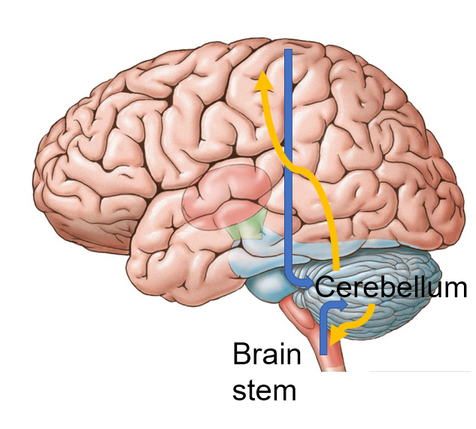
The Cerebellum
Function: evaluates difference between intended and actual movement action
Cortex, brain stem and spinal cord send signals TOWARDS
Cerebellum sends signals BACK, however these can be modified for motor learning

Slide 14
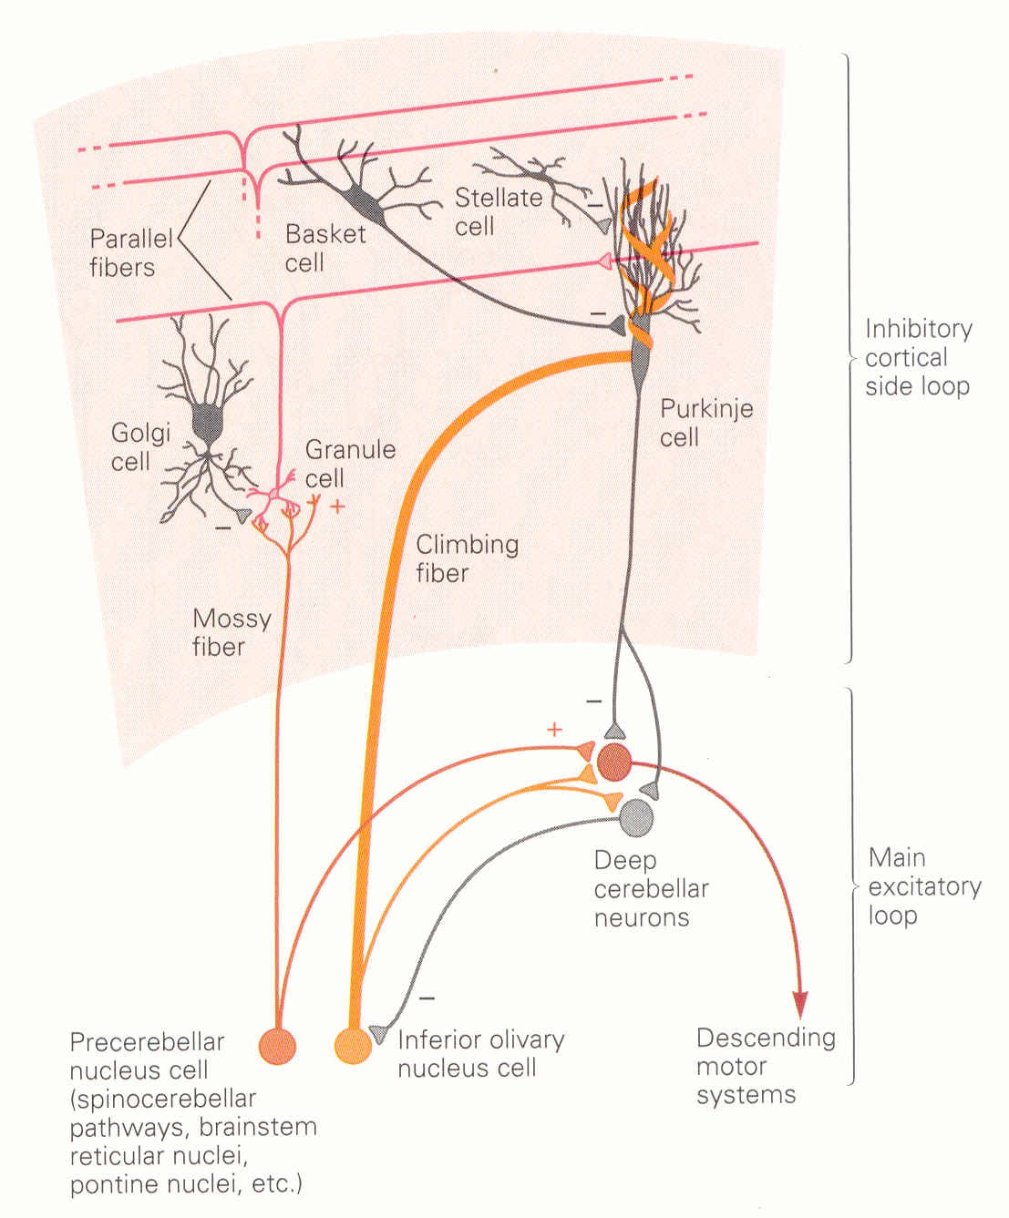
The Cerebellum Circuit
Two inputs:
Mossy fibers: Synapse on granule cells.
Axons of granule cells form parallel fibers which synapse on Purkinje cells
Climbing fibers: Synapse directly on Purkinje cells.
Mossy and climbing fibers excite Purkinjie cells, which provide cerebellum output through inhibition

Slide 15
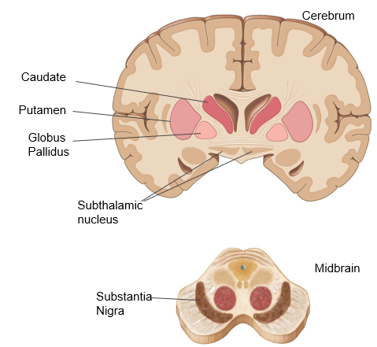
The Basal Ganglia
Function: regulating and planning movements
Cortex send signals TOWARDS
Basal ganglia sends signals BACK through the thalamus
Two main functions
Production of movement – direct pathway
Inhibition of movement – indirect pathway

Slide 16
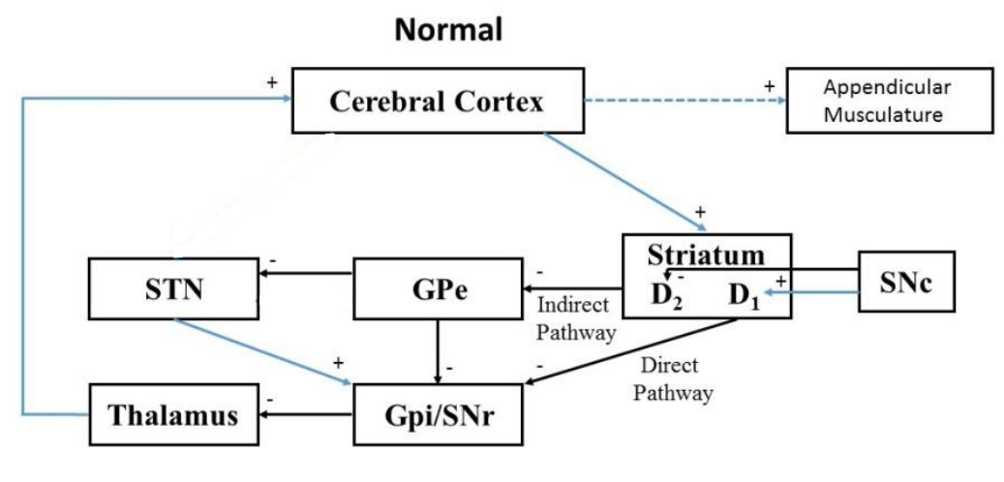
Basal Ganglia Circuit
Cerebral cortex sends excitatory signals to striatum (caudate + putamen)
Direct pathway (movement):
striatum inhibitory projections to globus pallidus internal
globus pallidus inhibitory projections to thalamus
Indirect pathway (Inhibit movement):
striatum inhibitory projections to globus pallidus external
globus pallidus external inhibitory projections to subthalamic nucleus
subthalmic nucleus excitatory projections to globus pallidus internal
globus pallidus internal inhibitory projections to thalamus
thalamus excitatory projections to cortex

Slide 17
Less Dopamine
Less dopamine from substantia nigra pars compacta
Direct pathway DE-ACTIVATED:
striatum will not inhibit the globus pallidus internal
Indirect pathway ACTIVATED:
striatum will inhibit globus pallidus external
globus pallidus external will no longer inhibit the subthalamic nucleus
subthalmic nucleus will cause excitation of globus pallidus internal
globus pallidus internal inhibits the thalamus
thalamus will no longer excite the cortex
Movement inhibited
Less dopamine
excitatory
inhibitory

Slide 18
More Dopamine
More dopamine from substantia nigra pars compacta
Direct pathway ACTIVATED:
striatum will inhibit the globus pallidus internal
globus pallidus internal will no longer inhibit the thalamus
Indirect pathway DE-ACTIVATED:
striatum will no longer inhibit the globus pallidus external
globus pallidus external will inhibit the subthalamic nucleus
subthalmic nucleus will no longer excite the globus pallidus internal
globus pallidus internal no longer inhibits the thalamus
thalamus will excite the cortex
Movement initiated
More dopamine
excitatory
inhibitory

Slide 19
Parkinson Disease
Loss of neurons in substantia nigra pars compacta
Direct pathway DE-ACTIVATED:
striatum will not inhibit the globus pallidus internal
Indirect pathway ACTIVATED:
striatum will inhibit globus pallidus external
globus pallidus external will no longer inhibit the subthalamic nucleus
subthalmic nucleus will cause excitation of globus pallidus internal
globus pallidus internal inhibits the thalamus
thalamus will no longer excite the cortex
Movement inhibited
Less dopamine
excitatory
inhibitory

Slide 20
Endocrine: Anterior pituitary and thyroid
Chapter 3: Dr. Beye

Slide 21
Where are the neurohormones released by the posterior pituitary produced?
by neuroglia located at the end of the posterior pituitary
in the neuronal cell bodies found in the hypothalamus
by the endocrine cells located within the posterior pituitary
in the axon terminal of the neurons that project from the hypothalamus through to the infundibulum

Slide 22
Where are the neurohormones released by the posterior pituitary produced?
by neuroglia located at the end of the posterior pituitary
in the neuronal cell bodies found in the hypothalamus
by the endocrine cells located within the posterior pituitary
in the axon terminal of the neurons that project from the hypothalamus through to the infundibulum

Slide 23
What is true of oxytocin?
It is made by the posterior pituitary
It acts on an intracellular receptor
It dissolves in the blood
It mediates a slow response

Slide 24
What is true of oxytocin?
It is made by the posterior pituitary
It acts on an intracellular receptor
It dissolves in the blood
It mediates a slow response

Slide 25
Hypothalamus-Anterior Pituitary
GnRH
Gonadotropin releasing hormone
FSH and LH
Gonads
CRH
Corticotropin releasing hormone
ACTH
Adrenal glands
TRH
Thyrotropin releasing hormone
TSH
Thyroid
Dopamine
(Inhibitory)
Prolactin
Mammary glands
GHRH
Growth hormone releasing hormone
GH
Bone, liver, skeletal muscle and fat
Hypothalamus
Anterior
pituitary
Target
Hypothalamus makes and releases hormone into portal system
Hormone travels through hypothalamic hypophyseal portal system to ant pit
Hormone acts on ant pit to make and release a hormone into general circulation
Hormone travels through general circulation to target tissue

Slide 26
If the hypothalamic-hypophyseal portal system was destroyed…
Prolactin would not be circulating
GnRH would not be circulating
Thyroid hormone would be circulating
No hormones would be circulating

Slide 27
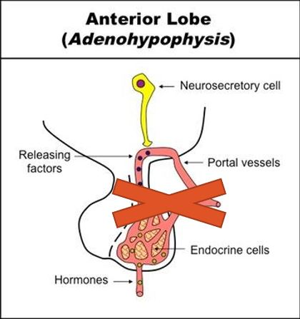
If the hypothalamic-hypophyseal portal system was destroyed…
Prolactin would not be circulating
GnRH would not be circulating
Thyroid hormone would be circulating
No hormones would be circulating
GnRH
Gonadotropin releasing hormone
FSH and LH
Gonads

Slide 28
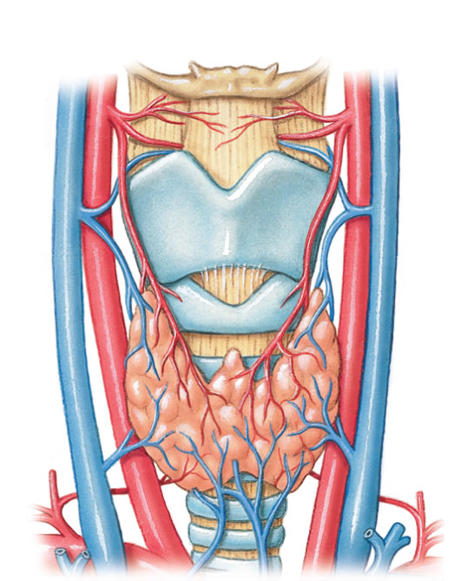
Thyroid Gland
Thyroid Cartilage
Thyroid Gland
Trachea

Slide 29
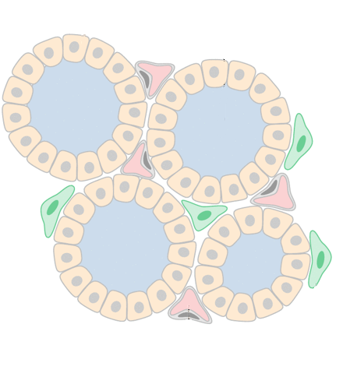
Thyroid Gland
Follicular cell
Colloid
Capillary: TH transport
Follicle: functional unit where TH is made
Colloid: TH is made and stored here
Follicular cells: acquire and produce TH building blocks
Follicle
Capillary

Slide 30
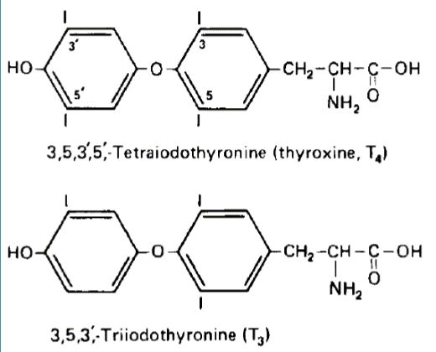
Thyroid Hormone Overview
TH is an amine hormone with properties similar to steroid hormone
Function: increase basal metabolic rate; acts on nearly every cell of body
2 key components: tyrosine and iodide

Slide 31
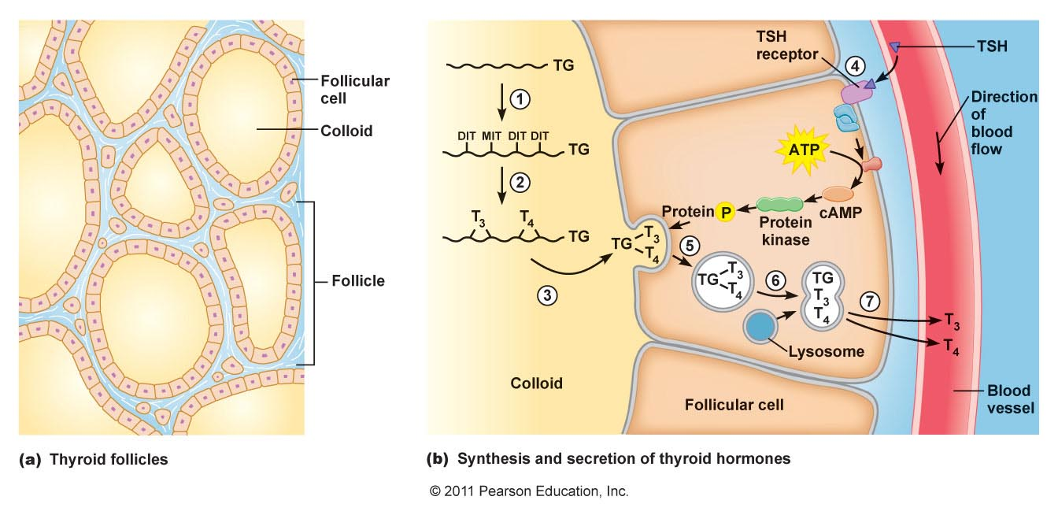
Thyroid Hormone Synthesis
Tyrosine residues of thyroglobulin iodinated
Two iodinated residues join by covalent bond
Thyroid hormones stored in colloid
TSH binds receptor and activates thyroid hormone synthesis
Follicular cells take in thyroglobulin by endocytosis
Endosome fuses with lysosome
Lysosomal enzymes cause release of T3 and T4
T3 and T4 diffuse into bloodstream

Slide 32
Which of these hormones have the same target tissues or cells?
TRH and T4
ADH and CRH
Prolactin and Vasopressin
TSH and GHRH

Slide 33
Which of these hormones have the same target tissues or cells?
TRH and T4
ADH and CRH
Prolactin and Vasopressin
TSH and GHRH

Slide 34
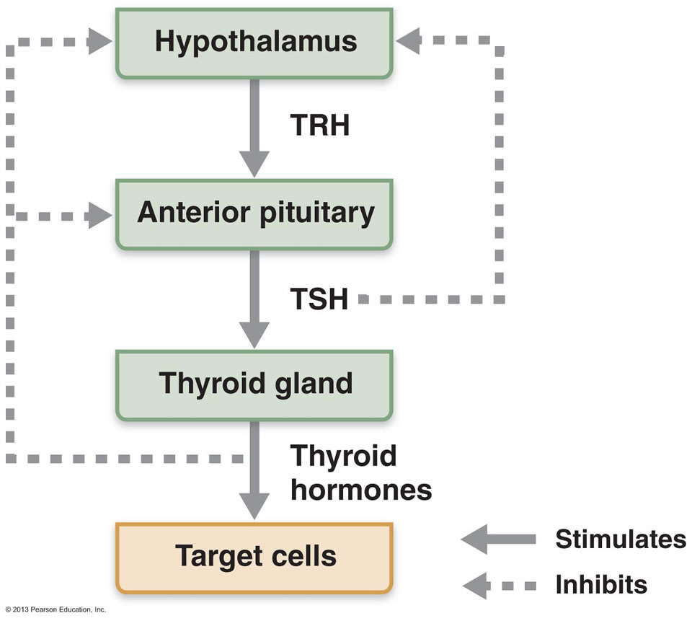
Thyroid Hormone Modulation

Slide 35
Thyroid Gland and Adrenal Gland
Chapter 3: Dr. Beye

Slide 36
Thyroid Gland Disorders
 | Hyperthyroidism | Hypothyroidism
Symptoms | Weight loss Increase HR Sensitive to heat Fidgety, hyperactive, irritable | Weight gain Decrease HR Sensitive to cold Fatigue, depression
Causes | TRH or TSH (leads to Goiter) Grave’s disease: Ab to TSH receptor | TRH TSH Poor diet/iodide deficiency (leads to Goiter) Can also result in atrophy: Autoimmune destruction of thyroid gland

Slide 37
Adrenal Gland: Layers (Not on midterm)
 | Layers | Categories of Hormones | Example | Stimulus | Effect
Cortex | Zona glomerulosa | Mineralocorticoids | Aldosterone | RAAS pathway (@ low BP) | Increase Na⁺ reabsoprtion
Cortex | Zona fasciculata | Glucocorticoids | Cortisol | ACTH | -
Cortex | Zona reticularis | Androgens | DHEA | - | -
Medulla | Medulla | Catecholamines | Epinephrine | Sympathetic Nervous System | SNS response
Three classes of steroids: Mineralocorticoids, Glucocorticoids and Androgens

Slide 38
Next Tutorial (Oct 29th)
Endocrinology

Slide 39
What Questions Do You Have?
You can ask in the Owl forums as well!
Also anonymously ask questions in the online dropbox!!

